Slide 1

TECHNICAL SEMINAR
PAPER BATTERY
Carbon nanotubes
SUBMITTED TO:
Asst. Prof. ALOK KUMAR
(ECE Dept.)
SUBMITTED BY:
Vishal Kumar
(1702731168)
Ajay Kumar Garg Engineering College, Ghaziabad

Slide 2
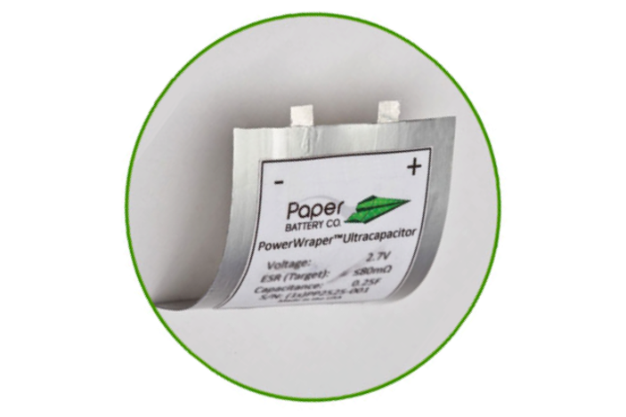
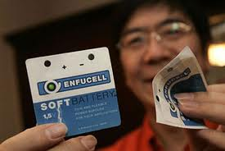
INTRODUCTION
CONTENT
Introduction to Paper Battery
Carbon Nanotubes
Properties
Construction
Working
Applications
Advantages
Limitations
Future Scope
Conclusion

Slide 3
INTRODUCTION
INTRODUCTION
A paper battery is a flexible, ultra-thin energy storage and production device formed by combining carbon nanotubes with a conventional sheet of cellulose-based paper.
The nano materials are a one-dimensional structure with very small diameters.  It can be bent and twisted, trimmed with scissors or molded into any needed shape.
In addition to being unusually thin, paper batteries are flexible and environment friendly ,allowing integration into wide range of products . Their functioning is similar to conventional chemical batteries with the important difference that they are non corrosive and do not require extensive housing.
Paper Battery = Carbon Nanotubes + Cellulose (Paper)

Slide 4
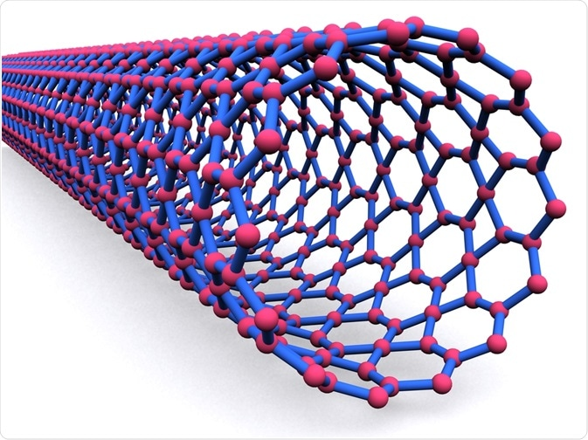
INTRODUCTION
CARBON NANOTUBES
Carbon nanotubes (CNTs) are allotropes of carbon with a cylindrical nanostructure. These cylindrical carbon molecules have unusual properties, which are valuable for nanotechnology, electronics, optics and other fields of materials science and technology.
In addition, owing to their extraordinary thermal conductivity, mechanical and electrical properties, carbon nanotubes find applications as additives to various structural materials. For instance, nanotubes from a tiny portion of the material in some (Primarily Carbon Fiber) baseball bats, golf clubs, car parts or Damascus steel

Slide 5
INTRODUCTION
PROPERTIES OF CARBON NANOTUBES
The carbon nanotubes are flexible and very light weight.
Carbon Nanotubes are good conductor of electricity.
Carbon Nanotubes offers high tensile strength
Carbon Nanotubes have high packing density and low mass density
Carbon Nanotubes provides low resistance.

Slide 6
INTRODUCTION
PROPERTIES OF CELLULOSE
Cellulose is a biodegradable and bio- compatible material
Cellulose provide low shear strength
Cellulose offers high tensile strength
Cellulose has magnificent absorption capacity and porosity.
Cellulose is nontoxic.
Can be easily recyclable and reusable.

Slide 7
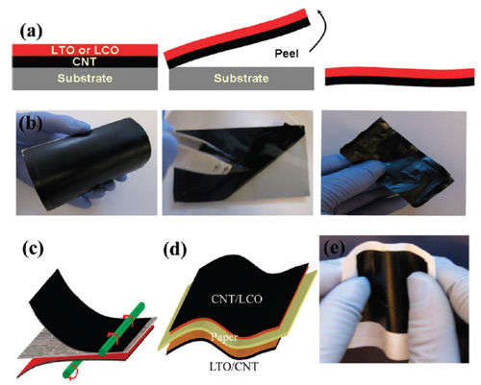
INTRODUCTION
CONSTRUCTION
Actually, there are many ways to construct paper batteries. Given below are three ways to create paper batteries:
The first method involves fabricating zinc and manganese dioxide based cathode and anode. The batteries are printed onto paper using standard silkscreen printing press.
This paper is infused with aligned carbon nanotubes which are used as electrode. This paper is dipped in a solution of ionic liquid which acts as the electrolyte
Brain Wave Detection Model

Slide 8
INTRODUCTION
2nd Method
The second method is a bit complex and involves growing nanotubes on a silicon substrate. The gaps in the matrix are then filled with cellulose and once the matrix is dried, the combination of cellulose and nanotubes is peeled off. Thus sheets of paper consisting of layers of carbon nanotubes are created. these Two such sheets are combined together to form a super capacitor with an ionic solution like urine, sweat or human blood as an electrolyte.

Slide 9
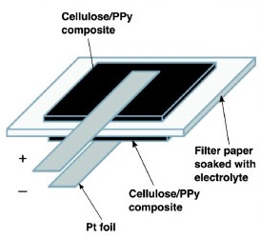
INTRODUCTION
3RD method
Step 1: Black carbon ink is applied on a cellulose based paper.
Step 2: Black Carbon ink is being spread on a paper spread on the paper.
Step 3: A thin lithium film is laminated over the exposed cellulose surface.
Step 4: The cellulose paper is heated at 80o C for 5 minutes.
Step 5: Next, the film is peeled off from the substrate
Step 6: The film acts as electrodes of the paper battery. One film is connected to the electrolyte LTO (Li4Ti5012) and another film is pasted to the electrolyte LCO (LiCo02).
Step 7: Next, connect a LED on both the ends of the battery and check its functionality

Slide 10
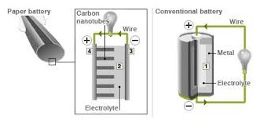
INTRODUCTION
WORKING
Internal operation of paper batteries is similar to that of conventional batteries with each battery generating about 1.5V.
If one can recall traditional batteries work in the manner where positive charged particles called ions and negative charged particles called electrons move between positive electrodes called anode and negative electrode called cathode. Current flows as electrons flow from anode to the cathode through the conductor, since the electrolyte is an insulator and doesn’t provide a free path for electrons to travel.
Basic internal structure of paper battery

Slide 11
INTRODUCTION
Working
Similarly in some paper batteries, carbon nanotubes act as cathode, the metal is the anode and paper is the separator.
Chemical reaction between metal and electrolyte results in production of ions whereas chemical reaction between carbon and electrolyte results in production of electrons. These electrons flow from the cathode to the anode through the external circuit.
? While a conventional battery contains a number of separate components, the paper battery integrates all of the battery components in a single structure, making it more energy efficient, Integrated devices. • The battery contains carbon nanotubes, each about one millionth of a centimeter thick, which act as an electrode. The nanotubes are embedded in a sheet of paper soaked in ionic liquid electrolytes, which conduct the electricity.

Slide 12
INTRODUCTION
APPLICATIONS
Paper battery can actually prove beneficial for applications where portability and size is the main requirement. Modern day electronic equipment's like smart cards, digital watches facilitate the requirement of thin batteries which are long lasting and non toxic.
Wearable Computers – One of the latest real time examples of wearable computers is Google Glass. It actually is a normal spectacle with an optical head mounted display and Glass is a computer in the form of a pair of eyeglasses and includes an optical head- mounted display which allows the user to use a smart phone.
It can also be used for low power devices like calculators, wrist watches and wireless communication devices like mouse, Bluetooth headphones, keypads etc.

Slide 13
INTRODUCTION
ADVANTAGES
Paper battery can be used as both supercapacitor and battery
Paper batteries are very flexible, ultrathin, nontoxic and biodegradable battery
Long life
Provide a steady power
Can be available in different shapes and sixes
They offer high energy efficiency
Paper batteries are low cost and can be easily disposed
They can be used to produce 1.5V energy and also paper batteries are rechargeable

Slide 14
INTRODUCTION
LIMITATIONS
Since cellulose has low shear strength, these batteries have low strength and can be torn easily.
The Techniques and the Set-ups used in the production of Carbon Nanotubes are very Expensive. There are different techniques are used like chemical vapor deposition(CVD), Arc discharge, Electrolysis, Laser Ablation etc.
If we inhaled the paper battery, they start interacting with the Microphages present in the lungs. This is very similar to that with asbestos fibers, hence may be seriously hazardous to human health.
These Batteries generates a E-wastage

Slide 15
INTRODUCTION
FUTURE SCOPE
It holds great potential to advance capabilities in portable power design for applications ranging from bioinstrumentation to consumer electronics and even large power systems served by conventional batteries.
In Electronics: In portable computer batteries, mobile phones, handheld digital cameras; the load of those devices can be considerably reduced by replacing the alkaline batteries, while not compromising, the electrical hazards associated with recharging are going to be greatly reduced
In a Medical Sciences - The paper like qualities of the material make it especially attractive for energy storage in medically implanted devices (for example, a pacemaker, insulin pump or the implantable radio chip
In Auto-mobiles and Aircraft.

Slide 16
INTRODUCTION
CONCLUTION
A paper battery is a paper like device formed by the combination of carbon nanotubes and a conventional sheet of cellulose-based paper which act as a flexible ultra-thin energy storage and energy production device.
As this technology is adapted it will prove to be extremely useful and could even save not only cost but lives also
Being biodegradable, Light weight and Non-Toxic, Flexible paper batteries have potential adaptability to power consequent generation of electronics, Medical devices and hybrid vehicles, allowing for radical new styles and medical technologies

Slide 17
INTRODUCTION
REFRENCE
Imperial Journal of Interdisciplinary Research (IJIR) Vol-2, Issue-5, 2016 Paper Battery the Solution for Traditional Battery
Paper-based batteries: ELSEVIER Biosensors & Bioelectronics Thu H Nguyen, Arwa Fraiwan, Seokheun Choi n Bioelectronics & Microsystems Laboratory, Department of Electrical & Computer Engineering, State University of New York at Binghamton, 4400 Vestal Pkwy, Binghamton, NY 13902, USA https://www.researchgate.net/publication/259318076
www.wikipidea.com
https://www.google.com/.electronicshub.org%2Fpaper-battery-construction-working%2F&psig=AOvV

Slide 18


